Slide 1


CE-526 Term Project Part 1
Simply Supported Dynamic Timoshenko Beam
$$ψ\left(x,t\right)$$
$$w\left(x,t\right)$$
•
•
°
•
•
°
°
Beam of 1 Element

Slide 2
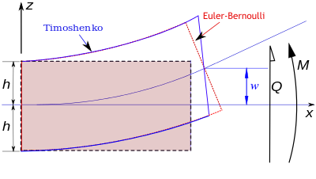
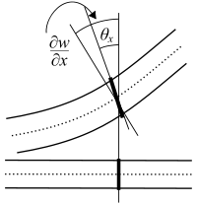

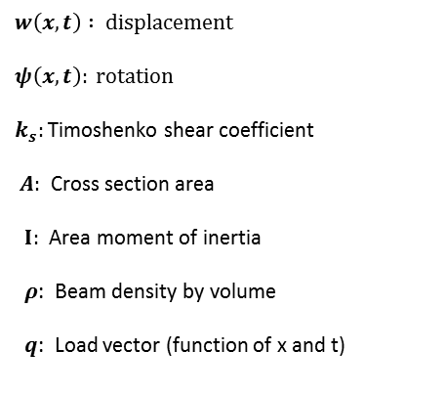

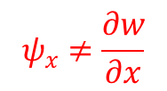
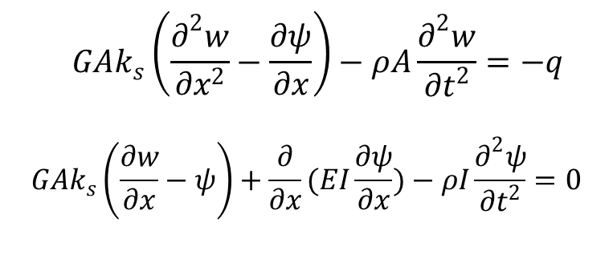
Dynamic Timoshenko Beam
$$\frac{∂^{2}}{∂x^{2}}\left(EI\frac{∂^{2}w}{∂x^{2}}\right)=−μ\frac{∂^{2}w}{∂t^{2}}+q(x,t)$$
$$ψ_{x}$$
$$ψ_{x}≠\frac{∂w}{∂x}$$
En.wikiversity.org
$$w\left(x,t\right) : displacement$$
$$ψ\left(x,t\right): rotation$$
$k_{s}:$ Timoshenko shear coefficient
$A:$ Cross section area
$I:$ Area moment of inertia
$ρ$: Beam density by volume
$q$: Load vector (function of x and t)
$$GAk_{s}\left(\frac{∂^{2}w}{∂x^{2}}−\frac{∂ψ}{∂x}\right)−ρA\frac{∂^{2}w}{∂t^{2}}=−q$$
$$GAk_{s}\left(\frac{∂w}{∂x}−ψ\right)+\frac{∂}{∂x}(EI\frac{∂ψ}{∂x})−ρI\frac{∂^{2}ψ}{∂t^{2}}=0$$
(1)
(2)

Slide 3
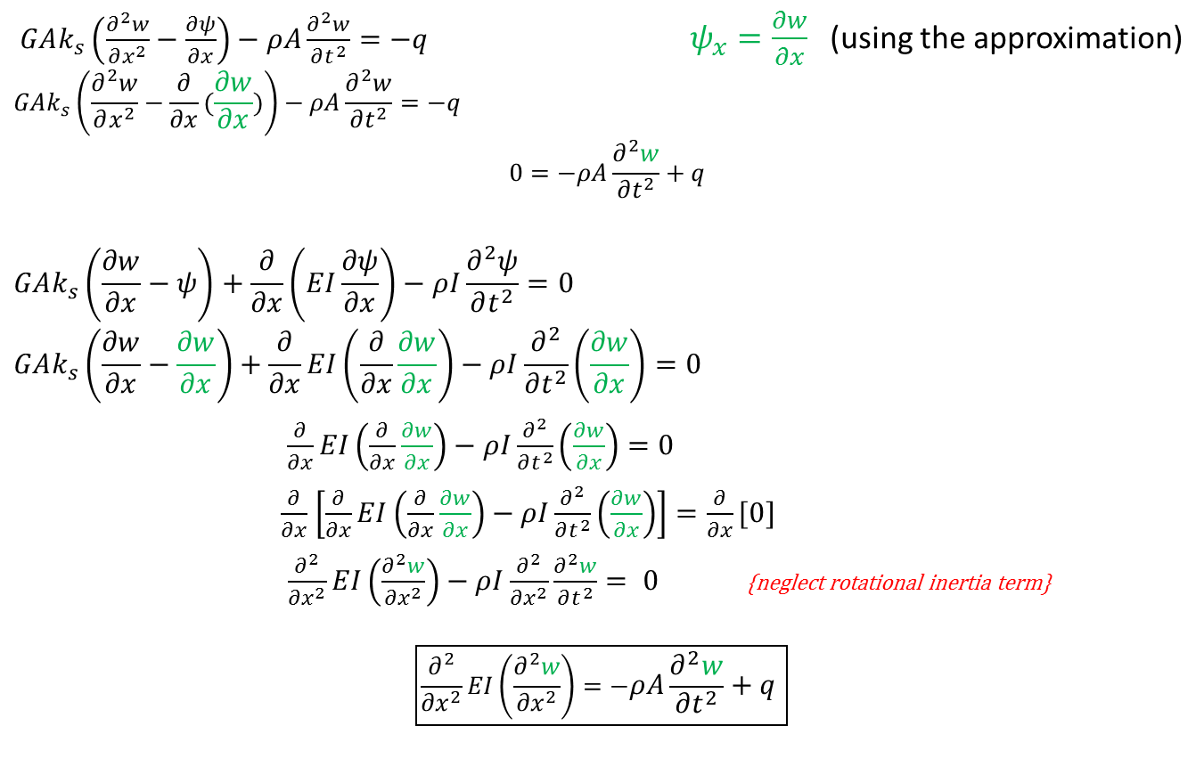
Timoshenko to Euler-Bernoulli
(1)
$GAk_{s}\left(\frac{∂^{2}w}{∂x^{2}}−\frac{∂ψ}{∂x}\right)−ρA\frac{∂^{2}w}{∂t^{2}}=−q$ $ψ_{x}=\frac{∂w}{∂x}$ (using the approximation)
$$GAk_{s}\left(\frac{∂^{2}w}{∂x^{2}}−\frac{∂}{∂x}(\frac{∂w}{∂x})\right)−ρA\frac{∂^{2}w}{∂t^{2}}=−q$$
$$0=−ρA\frac{∂^{2}w}{∂t^{2}}+q$$
$$GAk_{s}\left(\frac{∂w}{∂x}−ψ\right)+\frac{∂}{∂x}\left(EI\frac{∂ψ}{∂x}\right)−ρI\frac{∂^{2}ψ}{∂t^{2}}=0$$
$$GAk_{s}\left(\frac{∂w}{∂x}−\frac{∂w}{∂x}\right)+\frac{∂}{∂x}EI\left(\frac{∂}{∂x}\frac{∂w}{∂x}\right)−ρI\frac{∂^{2}}{∂t^{2}}\left(\frac{∂w}{∂x}\right)=0$$
$\frac{∂}{∂x}EI\left(\frac{∂}{∂x}\frac{∂w}{∂x}\right)−ρI\frac{∂^{2}}{∂t^{2}}\left(\frac{∂w}{∂x}\right)=0$
$\frac{∂}{∂x}$ $\left[\frac{∂}{∂x}EI\left(\frac{∂}{∂x}\frac{∂w}{∂x}\right)−ρI\frac{∂^{2}}{∂t^{2}}\left(\frac{∂w}{∂x}\right)\right]=\frac{∂}{∂x}[0]$
$\left.\frac{∂^{2}}{{∂x}^{2}}EI\left(\frac{∂^{2}w}{{∂x}^{2}}\right)−ρI\frac{∂^{2}}{{∂x}^{2}}\frac{∂^{2}w}{∂t^{2}}\right.= 0$ {neglect rotational inertia term}
$$\boxed{\frac{∂^{2}}{{∂x}^{2}}EI\left(\frac{∂^{2}w}{{∂x}^{2}}\right)=−ρA\frac{∂^{2}w}{∂t^{2}}+q }$$
(2)
{Take derivative of both sides (x)}
{Euler-Bernoulli}
Notes:
Derivation from (Meirovitch, 1986)

Slide 4

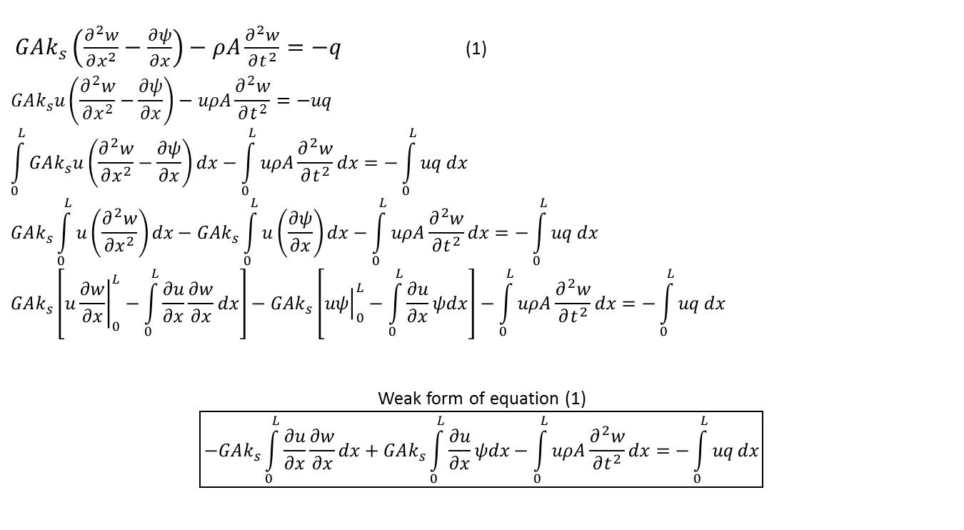
Timoshenko Weak Form (1)
$$w\left(x,t\right) ≈{\overline{φ}}^{T}\left(x\right)\overline{w}\left(t\right): displacement$$
$$u\left(x\right) ≈{\overline{u}}^{T}\overline{φ}\left(x\right): displacement test Function$$
${\overline{φ}}^{T}\left(x\right): vector of shape functions$
$$\overline{w}\left(t\right): displacement solution vector$$
$ψ\left(x,t\right) ≈{\overline{g}}^{T}\left(x\right)\overline{ψ}\left(t\right):$ $rotation$
$$v\left(x\right) ≈{\overline{v}}^{T}\overline{g}(x)rotation test Function$$
${\overline{g}}^{T}\left(x\right): vector of shape functions$
$$\overline{ψ}\left(t\right):rotation solution vector$$
$$w\left(0,t\right)=0, w\left(L,t\right)=0, EI\frac{∂ψ}{∂x}\left(0,t\right)=0, EI\frac{∂ψ}{∂x}\left(L,t\right)=0$$
$$w\left(x,0\right)=0, ψ\left(x,0\right)=0, \frac{∂w}{∂t}\left(x,0\right)=0, \frac{∂ψ}{∂t}\left(x,0\right)=0$$
$GAk_{s}\left(\frac{∂^{2}w}{∂x^{2}}−\frac{∂ψ}{∂x}\right)−ρA\frac{∂^{2}w}{∂t^{2}}=−q$ (1)
$$GAk_{s}u\left(\frac{∂^{2}w}{∂x^{2}}−\frac{∂ψ}{∂x}\right)−uρA\frac{∂^{2}w}{∂t^{2}}=−uq$$
$$\int_{0}^{L}{GAk_{s}u\left(\frac{∂^{2}w}{∂x^{2}}−\frac{∂ψ}{∂x}\right)dx}−\int_{0}^{L}{uρA\frac{∂^{2}w}{∂t^{2}}dx}=−\int_{0}^{L}{uq}dx$$
$$GAk_{s}\int_{0}^{L}{u\left(\frac{∂^{2}w}{∂x^{2}}\right)dx}−GAk_{s}\int_{0}^{L}{u\left(\frac{∂ψ}{∂x}\right)dx}−\int_{0}^{L}{uρA\frac{∂^{2}w}{∂t^{2}}dx}=−\int_{0}^{L}{uq}dx$$
$$GAk_{s}\left[u{\left.\frac{∂w}{∂x}\right|}_{0}^{L}−\int_{0}^{L}{\frac{∂u}{∂x}\frac{∂w}{∂x}}dx\right]−GAk_{s}\left[{\left.uψ\right|}_{0}^{L}−\int_{0}^{L}{\frac{∂u}{∂x}}ψdx\right]−\int_{0}^{L}{uρA\frac{∂^{2}w}{∂t^{2}}dx}=−\int_{0}^{L}{uq}dx$$
Weak form of equation (1)
$$\boxed{−GAk_{s}\left.\int_{0}^{L}{\frac{∂u}{∂x}\frac{∂w}{∂x}}dx\right.+GAk_{s}\int_{0}^{L}{\frac{∂u}{∂x}}ψdx−\int_{0}^{L}{uρA\frac{∂^{2}w}{∂t^{2}}dx}=−\int_{0}^{L}{uq}dx}$$

Slide 5

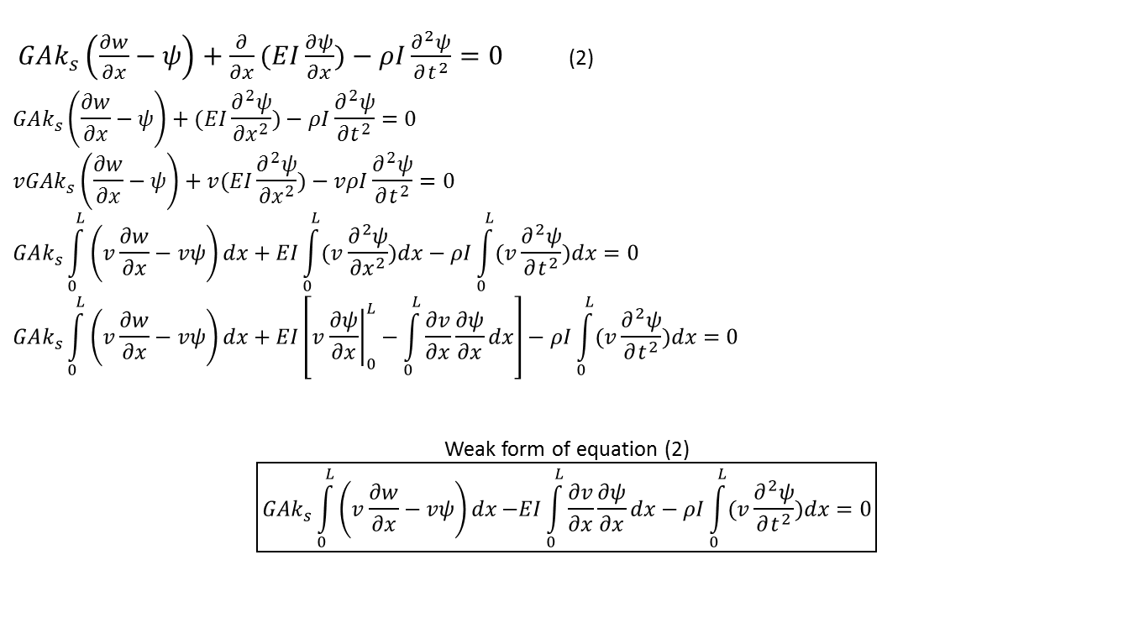
Timoshenko Weak Form (2)
$$w\left(x,t\right) ≈{\overline{φ}}^{T}\left(x\right)\overline{w}\left(t\right): displacement$$
$$u\left(x\right) ≈{\overline{u}}^{T}\overline{φ}\left(x\right): displacement test Function$$
${\overline{φ}}^{T}\left(x\right): vector of shape functions$
$$\overline{w}\left(t\right): displacement solution vector$$
$ψ\left(x,t\right) ≈{\overline{g}}^{T}\left(x\right)\overline{ψ}\left(t\right):$ $rotation$
$$v\left(x\right) ≈{\overline{v}}^{T}\overline{g}(x)rotation test Function$$
${\overline{g}}^{T}\left(x\right): vector of shape functions$
$$\overline{ψ}\left(t\right):rotation solution vector$$
$$w\left(0,t\right)=0, w\left(L,t\right)=0, EI\frac{∂ψ}{∂x}\left(0,t\right)=0, EI\frac{∂ψ}{∂x}\left(L,t\right)=0$$
$$w\left(x,0\right)=0, ψ\left(x,0\right)=0, \frac{∂w}{∂t}\left(x,0\right)=0, \frac{∂ψ}{∂t}\left(x,0\right)=0$$
$GAk_{s}\left(\frac{∂w}{∂x}−ψ\right)+\frac{∂}{∂x}(EI\frac{∂ψ}{∂x})−ρI\frac{∂^{2}ψ}{∂t^{2}}=0$ (2)
$$GAk_{s}\left(\frac{∂w}{∂x}−ψ\right)+(EI\frac{∂^{2}ψ}{{∂x}^{2}})−ρI\frac{∂^{2}ψ}{∂t^{2}}=0$$
$$vGAk_{s}\left(\frac{∂w}{∂x}−ψ\right)+v(EI\frac{∂^{2}ψ}{{∂x}^{2}})−vρI\frac{∂^{2}ψ}{∂t^{2}}=0$$
$$GAk_{s}\int_{0}^{L}{\left(v\frac{∂w}{∂x}−vψ\right)dx}+EI\int_{0}^{L}{(v\frac{∂^{2}ψ}{{∂x}^{2}})dx}−ρI\int_{0}^{L}{(v\frac{∂^{2}ψ}{∂t^{2}})dx}=0$$
$$GAk_{s}\int_{0}^{L}{\left(v\frac{∂w}{∂x}−vψ\right)dx}+EI\left[v{\left.\frac{∂ψ}{∂x}\right|}_{0}^{L}−\int_{0}^{L}{\frac{∂v}{∂x}}\frac{∂ψ}{∂x}dx\right]−ρI\int_{0}^{L}{(v\frac{∂^{2}ψ}{∂t^{2}})dx}=0$$
Weak form of equation (2)
$$\boxed{GAk_{s}\int_{0}^{L}{\left(v\frac{∂w}{∂x}−vψ\right)dx}\left.−EI\int_{0}^{L}{\frac{∂v}{∂x}}\frac{∂ψ}{∂x}dx\right.−ρI\int_{0}^{L}{(v\frac{∂^{2}ψ}{∂t^{2}})dx}=0}$$

Slide 6
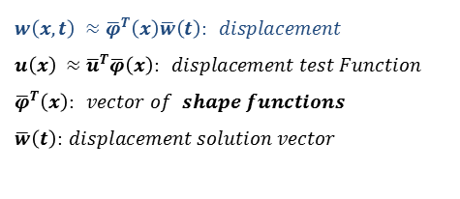
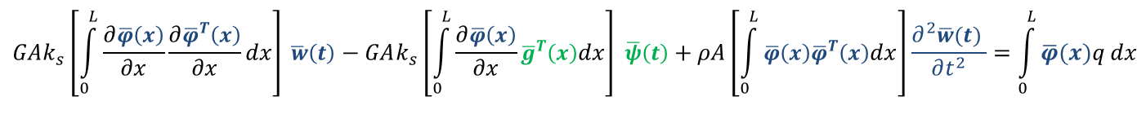
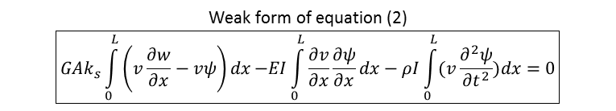

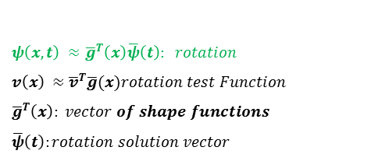
Applying Galerkin Approximations
$ψ\left(x,t\right) ≈{\overline{g}}^{T}\left(x\right)\overline{ψ}\left(t\right):$ $rotation$
$$v\left(x\right) ≈{\overline{v}}^{T}\overline{g}(x)rotation test Function$$
${\overline{g}}^{T}\left(x\right): vector of shape functions$
$$\overline{ψ}\left(t\right):rotation solution vector$$
$$w\left(x,t\right) ≈{\overline{φ}}^{T}\left(x\right)\overline{w}\left(t\right): displacement$$
$$u\left(x\right) ≈{\overline{u}}^{T}\overline{φ}\left(x\right): displacement test Function$$
${\overline{φ}}^{T}\left(x\right): vector of shape functions$
$$\overline{w}\left(t\right): displacement solution vector$$
Weak form of equation (1)
$$\boxed{−GAk_{s}\left.\int_{0}^{L}{\frac{∂u}{∂x}\frac{∂w}{∂x}}dx\right.+GAk_{s}\int_{0}^{L}{\frac{∂u}{∂x}}ψdx−\int_{0}^{L}{uρA\frac{∂^{2}w}{∂t^{2}}dx}=−\int_{0}^{L}{uq}dx}$$
$$GAk_{s}\left.\left[\int_{0}^{L}{\frac{∂\overline{φ}\left(x\right)}{∂x}\frac{∂{\overline{φ}}^{T}\left(x\right)}{∂x}}dx\right]\overline{ w}\left(t\right)\right.−GAk_{s}\left[\int_{0}^{L}{\frac{∂\overline{φ}\left(x\right)}{∂x}}{\overline{g}}^{T}\left(x\right)dx\right] \overline{ψ}\left(t\right)+ρA\left[\int_{0}^{L}{\overline{φ}\left(x\right){\overline{φ}}^{T}\left(x\right)dx}\right]\frac{∂^{2}\overline{w}(t) }{∂t^{2}}=\int_{0}^{L}{\overline{φ}(x)q}dx$$
Weak form of equation (2)
$$\boxed{GAk_{s}\int_{0}^{L}{\left(v\frac{∂w}{∂x}−vψ\right)dx}\left.−EI\int_{0}^{L}{\frac{∂v}{∂x}}\frac{∂ψ}{∂x}dx\right.−ρI\int_{0}^{L}{(v\frac{∂^{2}ψ}{∂t^{2}})dx}=0}$$
$$−GAk_{s}\left[\int_{0}^{L}{\left(\overline{g}\left(x\right)\frac{∂{\overline{φ}}^{T}\left(x\right)}{∂x}\right)dx}\right]\overline{ w}\left(t\right)+GAk_{s}\left[\int_{0}^{L}{\overline{g}\left(x\right){\overline{g}}^{T}\left(x\right)dx }\right]\overline{ψ}\left(t\right)+EI\left[\int_{0}^{L}{\frac{∂\overline{g}\left(x\right)}{∂x}}\frac{∂{\overline{g}}^{T}\left(x\right)}{∂x}dx\right]\overline{ψ}\left(t\right)+ρI\left[\int_{0}^{L}{\left(\overline{g}\left(x\right){\overline{g}}^{T}\left(x\right)\right)dx}\right]\frac{∂^{2}\overline{ψ}\left(t\right)}{∂t^{2}}=0$$

Slide 7
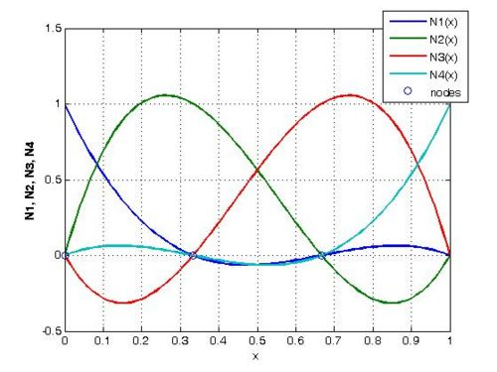
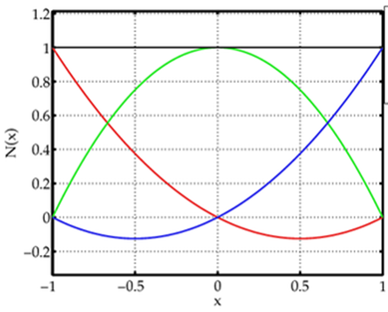




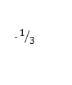


Choosing Shape Functions
$$ψ\left(x,t\right)$$
$$w\left(x,t\right)$$
•
•
°
•
•
°
°
Beam of 1 Element
g(x) : quadratic shape function
$φ$(x) : cubic shape function
3 Nodes:
4 Nodes: •
°
°
°
°
•
•
•
•
-1
$$−1/3$$
0
$$1/3$$
1
$$rotation: ψ\left(x,t\right) ≈{\overline{g}}^{T}\left(x\right)\overline{ψ}\left(t\right)$$
$$displacement: w\left(x,t\right) ≈{\overline{φ}}^{T}\left(x\right)\overline{w}\left(t\right)$$

Slide 8



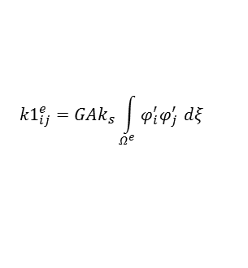
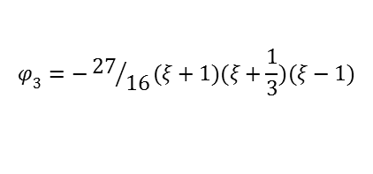
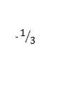
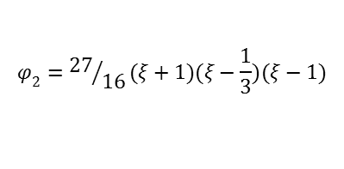
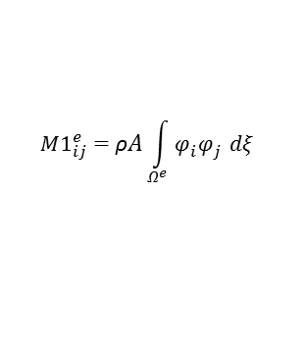

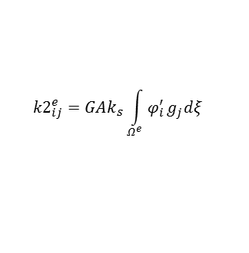


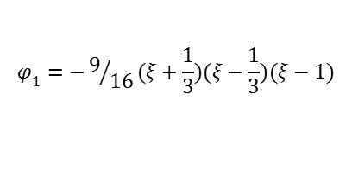
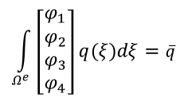



(1) in Matrix Form {Element}
[4x4]
[4x3]
[4x4]
[4x1]
$$GAk_{s}\left.\left[\int_{0}^{L}{\frac{∂\overline{φ}\left(x\right)}{∂x}\frac{∂{\overline{φ}}^{T}\left(x\right)}{∂x}}dx\right]\overline{ w}\left(t\right)\right.−GAk_{s}\left[\int_{0}^{L}{\frac{∂\overline{φ}\left(x\right)}{∂x}}{\overline{g}}^{T}\left(x\right)dx\right] \overline{ψ}\left(t\right)+ρA\left[\int_{0}^{L}{\overline{φ}\left(x\right){\overline{φ}}^{T}\left(x\right)dx}\right]\frac{∂^{2}\overline{w}(t) }{∂t^{2}}=\int_{0}^{L}{\overline{φ}(x)q(x)}dx$$
$${k1}_{ij}^{e}=GAk_{s}\int_{Ω^{e}}{φ_{i}^{′}φ_{j}^{′} }dξ$$
$${k2}_{ij}^{e}=GAk_{s}\int_{Ω^{e}}{φ_{i}^{′}}g_{j}^{}dξ$$
$${M1}_{ij}^{e}=\text{ρ}A\int_{Ω^{e}}{φ_{i}^{}φ_{j}^{} }dξ$$
$$\int_{Ω^{e}}{\left[\begin{aligned}φ_{1} \\ φ_{2} \\ φ_{3} \\ φ_{4}\end{aligned}\right]q(ξ)dξ=\overline{q}}$$
For i=1 to 4, j=1 to 4
For i=1 to 4, j=1 to 3
For i=1 to 4, j=1 to 4
°
°
°
°
°
°
°
-1
$$−1/3$$
0
$$1/3$$
1
$$g_{3}=\frac{(ξ^{2}+ξ)}{2}$$
$$φ_{1}=−9/{16}(ξ+\frac{1}{3})(ξ−\frac{1}{3})(ξ−1)$$
$$g_{1}=\frac{(ξ^{2}−ξ)}{2}$$
$$g_{2}=1−ξ^{2}$$
$$φ_{2}={27}/{16}(ξ+1)(ξ−\frac{1}{3})(ξ−1)$$
$$\left.\overline{ w}\left(t\right)\right.− \overline{ ψ}\left(t\right)+ \frac{∂^{2}\overline{w}(t) }{∂t^{2}}=$$
$$φ_{3}=−{27}/{16}(ξ+1)(ξ+\frac{1}{3})(ξ−1)$$
$$\overset{̿}{k1}$$
$$\overset{̿}{k2}$$
$$\overset{̿}{M1}$$
$$\overline{q}$$
(1)
$$φ_{4}=9/{16}(ξ+1)(ξ+\frac{1}{3})(ξ−\frac{1}{3})$$

Slide 9



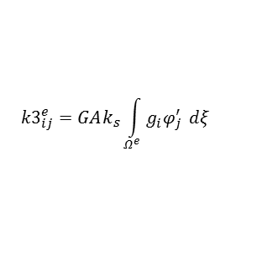

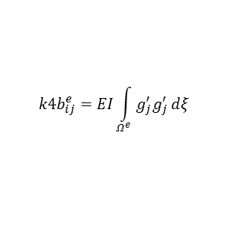
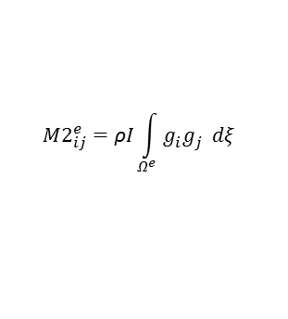


(2) in Matrix Form {Element}
[3x4]
[3x3]
[3x3]
[3x3]
[3x1]
$$−GAk_{s}\left[\int_{0}^{L}{\left(\overline{g}\left(x\right)\frac{∂{\overline{φ}}^{T}\left(x\right)}{∂x}\right)dx}\right]\overline{ w}\left(t\right)+GAk_{s}\left[\int_{0}^{L}{\overline{g}\left(x\right){\overline{g}}^{T}\left(x\right)dx }\right]\overline{ψ}\left(t\right)+EI\left[\int_{0}^{L}{\frac{∂\overline{g}\left(x\right)}{∂x}}\frac{∂{\overline{g}}^{T}\left(x\right)}{∂x}dx\right]\overline{ψ}\left(t\right)+ρI\left[\int_{0}^{L}{\left(\overline{g}\left(x\right){\overline{g}}^{T}\left(x\right)\right)dx}\right]\frac{∂^{2}\overline{ψ}\left(t\right)}{∂t^{2}}=\overline{0}$$
$${k3}_{ij}^{e}=GAk_{s}\int_{Ω^{e}}{g_{i}^{}φ_{j}^{′} }dξ$$
$${M2}_{ij}^{e}=\text{ρ}I\int_{Ω^{e}}{g_{i}^{}g_{j}^{} }dξ$$
$$\left[\begin{aligned}0 \\ 0 \\ 0\end{aligned}\right]$$
$${k4a}_{ij}^{e}=GAk_{s}\int_{Ω^{e}}{g_{i}^{}}g_{j}^{}dξ$$
$${k4b}_{ij}^{e}=EI\int_{Ω^{e}}{g_{j}^{′}g_{j}^{′}}dξ$$
For i=1 to 3, j=1 to 4
For i=1 to 3, j=1 to 3
For i=1 to 3, j=1 to 3
For i=1 to 4, j=1 to 4
°
°
°
°
°
°
°
-1
$$−1/3$$
0
$$1/3$$
1
$$g_{3}=\frac{(ξ^{2}+ξ)}{2}$$
$$φ_{1}=−9/{16}(ξ+\frac{1}{3})(ξ−\frac{1}{3})(ξ−1)$$
$$g_{1}=\frac{(ξ^{2}−ξ)}{2}$$
$$g_{2}=1−ξ^{2}$$
$$φ_{2}={27}/{16}(ξ+1)(ξ−\frac{1}{3})(ξ−1)$$
$$φ_{3}=−{27}/{16}(ξ+1)(ξ+\frac{1}{3})(ξ−1)$$
$$\left.\overline{ w}\left(t\right)\right.+ \overline{ ψ}\left(t\right)+ \frac{∂^{2}\overline{ψ}(t) }{∂t^{2}}=$$
$$− \overset{̿}{k3}$$
[$\overset{̿}{k4a}+\overset{̿}{k4b}]$
$$\overset{̿}{M2}$$
$$\overline{0}$$
(2)
$$φ_{4}=9/{16}(ξ+1)(ξ+\frac{1}{3})(ξ−\frac{1}{3})$$

Slide 10
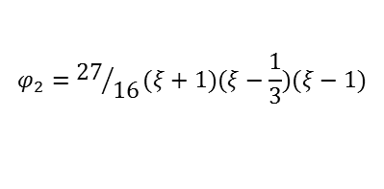
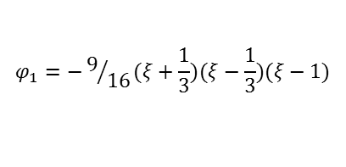
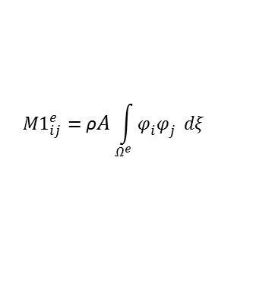
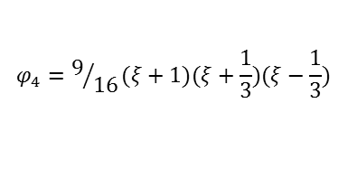
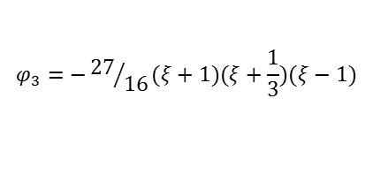
MATLAB Symbolic Integration
$$φ_{1}=−9/{16}(ξ+\frac{1}{3})(ξ−\frac{1}{3})(ξ−1)$$
$$φ_{2}={27}/{16}(ξ+1)(ξ−\frac{1}{3})(ξ−1)$$
$${M1}_{ij}^{e}=\text{ρ}A\int_{Ω^{e}}{φ_{i}^{}φ_{j}^{} }dξ$$
$$φ_{3}=−{27}/{16}(ξ+1)(ξ+\frac{1}{3})(ξ−1)$$
$$φ_{4}=9/{16}(ξ+1)(ξ+\frac{1}{3})(ξ−\frac{1}{3})$$
syms ksi;
phi1=-(9/16)*(ksi+(1/3))*(ksi-(1/3))*(ksi-1); %Cubic shape function 1
phi2=(27/16)*(ksi+1)*(ksi-(1/3))*(ksi-1); %Cubic shape function 2
phi3=-(27/16)*(ksi+1)*(ksi+(1/3))*(ksi-1); %Cubic shape function 3
phi4=(9/16)*(ksi+1)*(ksi+(1/3))*(ksi-(1/3)); %Cubic shape function 4
phi=[phi1 phi2 phi3 phi4]; %vector for calling cubic shape functions
dphi=diff(phi,ksi); %vector for calling derivative of cubic shape functions
M1E=[]; %element Mass Matrix 1
for i=1:4 %Loop that creates element Mass Matrix 1
for j=1:4
M1E(i,j)=(h/2)*rho*A*int(phi(i)*phi(j),-1,1);
end
end

Slide 11



















2 Matrix Equations Define the State
$$\left.\overline{ w}\left(t\right)\right.− \overline{ ψ}\left(t\right)+ \frac{∂^{2}\overline{w}(t) }{∂t^{2}}=$$
$$\overset{̿}{k1}$$
$$\overset{̿}{k2}$$
$$\overset{̿}{M1}$$
$$\overline{q}$$
(1)
$$\left.\overline{ w}\left(t\right)\right.+ \overline{ ψ}\left(t\right)+ \frac{∂^{2}\overline{ψ}(t) }{∂t^{2}}=$$
$$− \overset{̿}{k3}$$
[$\overset{̿}{k4a}+\overset{̿}{k4b}]$
$$\overset{̿}{M2}$$
$$\overline{0}$$
(2)
Combine
$$\left[\begin{aligned}q_{1} \\ q_{2} \\ q_{3} \\ q_{4} \\ 0 \\ 0 \\ 0\end{aligned}\right]$$
$$\overset{̿}{k1}$$
$$\overset{̿}{k2}$$
$$\overline{ w}\left(t\right)$$
$$\overset{̿}{M1}$$
$$\frac{∂^{2}\overline{w}(t) }{∂t^{2}}$$
0
+
=
(3)
-$\overset{̿}{k3}$
$$\overset{̿}{k4}$$
$$\overline{ ψ}\left(t\right)$$
0
$$\overset{̿}{M2}$$
$$\frac{∂^{2}\overline{ψ}(t) }{∂t^{2}}$$
[Kst]
[Mst]
[Qst]

Slide 12




Stiffness State (Element)
$$\overset{̿}{k1}$$
$$\overset{̿}{k2}$$
[Kst] =
$$\overset{̿}{k3}$$
$$\overset{̿}{k4}$$
[Kst] =

Slide 13


Mass State (Element)
$$\overset{̿}{M1}$$
0
[Mst] =
0
$$\overset{̿}{M2}$$
[Mst] =

Slide 14




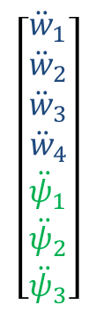
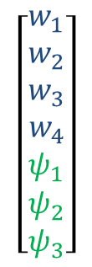
Displacement and Acceleration State
$$\left[\begin{matrix}w_{1} \\ w_{2} \\ w_{3} \\ w_{4} \\ ψ_{1} \\ ψ_{2} \\ ψ_{3}\end{matrix}\right]$$
$$\left[\begin{matrix}{\ddot{w}}_{1} \\ {\ddot{w}}_{2} \\ {\ddot{w}}_{3} \\ {\ddot{w}}_{4} \\ {\ddot{ψ}}_{1} \\ {\ddot{ψ}}_{2} \\ {\ddot{ψ}}_{3}\end{matrix}\right]$$
$$\frac{∂^{2}\overline{w}(t) }{∂t^{2}}$$
$$\overline{ w}\left(t\right)$$
$$\overline{ ψ}\left(t\right)$$
=
$$\frac{∂^{2}\overline{ψ}(t) }{∂t^{2}}$$
=

Slide 15
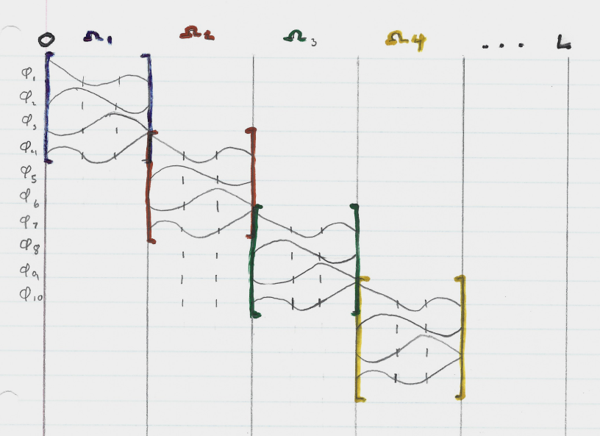
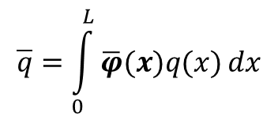
Load Vector
$$\overline{q}=\int_{0}^{L}{\overline{φ}(x)q(x)}dx$$

Slide 16
Building the State Load Vector
q=-load*sin(2*pi*f*t); %Creating Force Element Vector
ForceE=[];
for i=1:4
ForceE(i)=int(phi(i),-1,1)*(h/2);
end
ForceE=ForceE';
Qst=zeros(5*n+2,1); %Creating the full Force State vector
for i=1:3:3*n-2
Qst(i:i+3)=Qst(i:i+3)+ForceE;
end
Qst(3*n+1,:)=[]; %Applying boundary conditions
Qst(1,:)=[];
Qst=sparse(Qst);

Slide 17

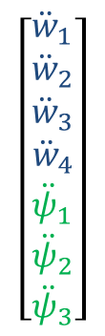
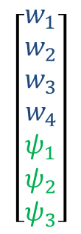

Finally an Equation to be Solved!
$$\left[\begin{aligned}q_{1} \\ q_{2} \\ q_{3} \\ q_{4} \\ 0 \\ 0 \\ 0\end{aligned}\right]$$
$$\overset{̿}{k1}$$
$$\overset{̿}{k2}$$
$$\overline{ w}\left(t\right)$$
$$\overset{̿}{M1}$$
$$\frac{∂^{2}\overline{w}(t) }{∂t^{2}}$$
0
+
=
$$\overset{̿}{k3}$$
$$\overset{̿}{k4}$$
$$\overline{ ψ}\left(t\right)$$
0
$$\overset{̿}{M2}$$
$$\frac{∂^{2}\overline{ψ}(t) }{∂t^{2}}$$
[Kst]
[Mst]
[Qst]
$$\left[\begin{matrix}w_{1} \\ w_{2} \\ w_{3} \\ w_{4} \\ ψ_{1} \\ ψ_{2} \\ ψ_{3}\end{matrix}\right]$$
$$\left[\begin{matrix}{\ddot{w}}_{1} \\ {\ddot{w}}_{2} \\ {\ddot{w}}_{3} \\ {\ddot{w}}_{4} \\ {\ddot{ψ}}_{1} \\ {\ddot{ψ}}_{2} \\ {\ddot{ψ}}_{3}\end{matrix}\right]$$
$$\left[\begin{aligned}q_{1} \\ q_{2} \\ q_{3} \\ q_{4} \\ 0 \\ 0 \\ 0\end{aligned}\right]$$
+
=

Slide 18

Expanding the Element Matrices
M1G=zeros(3*n+1);
for i=1:3:3*n-2
M1G(i:i+3,i:i+3)=M1G(i:i+3,i:i+3)+M1E;
end

Slide 19
Same Process for Other Matrices
$$\left[\begin{aligned}q_{1} \\ q_{2} \\ q_{3} \\ q_{4} \\ 0 \\ 0 \\ 0\end{aligned}\right]$$
$$\overset{̿}{k1}$$
$$\overset{̿}{k2}$$
$$\overline{ w}\left(t\right)$$
$$\overset{̿}{M1}$$
$$\frac{∂^{2}\overline{w}(t) }{∂t^{2}}$$
0
+
=
$$\overset{̿}{k3}$$
$$\overset{̿}{k4}$$
$$\overline{ ψ}\left(t\right)$$
0
$$\overset{̿}{M2}$$
$$\frac{∂^{2}\overline{ψ}(t) }{∂t^{2}}$$
[Kst]
[Mst]
[Qst]
3n+1
3n+1
$$\left[\begin{matrix}w_{1} \\ w_{2} \\ w_{3} \\ w_{4} \\ ψ_{1} \\ ψ_{2} \\ ψ_{3}\end{matrix}\right]$$
$$\left[\begin{matrix}{\ddot{w}}_{1} \\ {\ddot{w}}_{2} \\ {\ddot{w}}_{3} \\ {\ddot{w}}_{4} \\ {\ddot{ψ}}_{1} \\ {\ddot{ψ}}_{2} \\ {\ddot{ψ}}_{3}\end{matrix}\right]$$
$$\left[\begin{aligned}q_{1} \\ q_{2} \\ q_{3} \\ q_{4} \\ 0 \\ 0 \\ 0\end{aligned}\right]$$
+
=
2n+1
2n+1

Slide 20
Apply Boundary Conditions
Same as previous assignments (removing rows and columns)
Kst=zeros(5*n+2,5*n+2); %Combining global stiffness matrix
Kst(1:3*n+1,1:3*n+1)=K1G;
Kst(1:3*n+1,3*n+2:5*n+2)=K2G;
Kst(3*n+2:5*n+2,1:3*n+1)=K3G;
Kst(3*n+2:5*n+2,3*n+2:5*n+2)=K4G;
Kst(:,3*n+1)=[]; %Applying boundary conditions
Kst(3*n+1,:)=[];
Kst(:,1)=[];
Kst(1,:)=[];
Mst(:,3*n+1)=[];
Mst(3*n+1,:)=[];
Mst(:,1)=[];
Mst(1,:)=[];
Mst=sparse(Mst);
Kst=sparse(Kst);

Slide 21

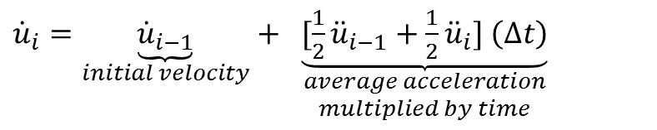

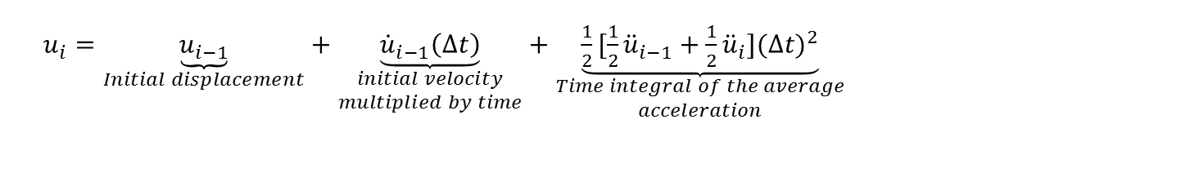

Newmark Time Integration Procedure
$u_{i}=\underset{Initial displacement}{\underbrace{u_{i−1}}}+\underset{\begin{aligned}initial velocity \\ multiplied by time\end{aligned}}{\underbrace{{\dot{u}}_{i−1}\left(∆t\right)}}+\underset{\begin{aligned}Time integral of the average \\ acceleration\end{aligned}}{\underbrace{\frac{1}{2}[\frac{1}{2}{\ddot{u}}_{i−1}+{\frac{1}{2}\ddot{u}}_{i}]{(∆t)}^{2}}}$
${\dot{u}}_{i}=\underset{initial velocity}{\underbrace{{\dot{u}}_{i−1}}}+ \underset{\begin{aligned}average acceleration \\ multiplied by time\end{aligned}}{\underbrace{[\frac{1}{2}{\ddot{u}}_{i−1}+{\frac{1}{2}\ddot{u}}_{i}] \left(∆t\right)}}$
$$\left[\begin{matrix}w_{1} \\ w_{2} \\ w_{3} \\ w_{4} \\ ψ_{1} \\ ψ_{2} \\ ψ_{3}\end{matrix}\right]$$
$$\left[\begin{matrix}{\ddot{w}}_{1} \\ {\ddot{w}}_{2} \\ {\ddot{w}}_{3} \\ {\ddot{w}}_{4} \\ {\ddot{ψ}}_{1} \\ {\ddot{ψ}}_{2} \\ {\ddot{ψ}}_{3}\end{matrix}\right]$$
$$\left[\begin{aligned}q_{1} \\ q_{2} \\ q_{3} \\ q_{4} \\ 0 \\ 0 \\ 0\end{aligned}\right]$$
+
=

Slide 22
Simulations
Distributed sinusoidal load
Sinusoidal point Load for .375 seconds followed by free oscillations
Fixed point at center, sinusoidal point load for .375 seconds followed by free oscillations

Slide 23
°
°
°
°
°
°
°
-1
$$−1/3$$
0
$$1/3$$
1

Slide 24
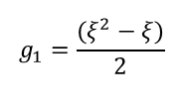
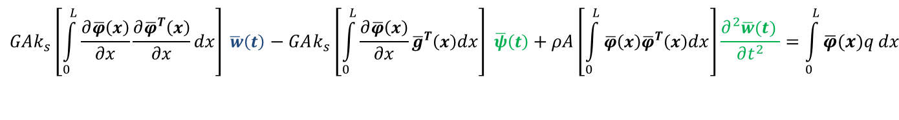
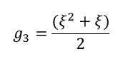

Applying Galerkin Approximations
[4x4]
[4x3]
[4x4]
[4x1]
$$GAk_{s}\left.\left[\int_{0}^{L}{\frac{∂\overline{φ}\left(x\right)}{∂x}\frac{∂{\overline{φ}}^{T}\left(x\right)}{∂x}}dx\right]\overline{ w}\left(t\right)\right.−GAk_{s}\left[\int_{0}^{L}{\frac{∂\overline{φ}\left(x\right)}{∂x}}{\overline{g}}^{T}\left(x\right)dx\right] \overline{ψ}\left(t\right)+ρA\left[\int_{0}^{L}{\overline{φ}\left(x\right){\overline{φ}}^{T}\left(x\right)dx}\right]\frac{∂^{2}\overline{w}(t) }{∂t^{2}}=\int_{0}^{L}{\overline{φ}(x)q}dx$$
[3x4]
[3x3]
[3x3]
[3x3]
[3x1]
$$−GAk_{s}\left[\int_{0}^{L}{\left(\overline{g}\left(x\right)\frac{∂{\overline{φ}}^{T}\left(x\right)}{∂x}\right)dx}\right]\overline{ w}\left(t\right)+GAk_{s}\left[\int_{0}^{L}{\overline{g}\left(x\right){\overline{g}}^{T}\left(x\right)dx }\right]\overline{ψ}\left(t\right)+EI\left[\int_{0}^{L}{\frac{∂\overline{g}\left(x\right)}{∂x}}\frac{∂{\overline{g}}^{T}\left(x\right)}{∂x}dx\right]\overline{ψ}\left(t\right)+ρI\left[\int_{0}^{L}{\left(\overline{g}\left(x\right){\overline{g}}^{T}\left(x\right)\right)dx}\right]\frac{∂^{2}\overline{ψ}\left(t\right)}{∂t^{2}}=0$$
°
°
°
°
°
°
°
$$g_{1}=\frac{(ξ^{2}−ξ)}{2}$$
$$g_{3}=\frac{(ξ^{2}+ξ)}{2}$$
-1
$$−1/3$$
0
$$1/3$$
1
$$g_{2}=1−ξ^{2}$$

Slide 25
Building Mass Element Matrix 1
syms ksi;
phi1=-(9/16)*(ksi+(1/3))*(ksi-(1/3))*(ksi-1); %Cubic shape function 1
phi2=(27/16)*(ksi+1)*(ksi-(1/3))*(ksi-1); %Cubic shape function 2
phi3=-(27/16)*(ksi+1)*(ksi+(1/3))*(ksi-1); %Cubic shape function 3
phi4=(9/16)*(ksi+1)*(ksi+(1/3))*(ksi-(1/3)); %Cubic shape function 4
phi=[phi1 phi2 phi3 phi4]; %vector for calling cubic shape functions
dphi=diff(phi,ksi); %vector for calling derivative of cubic shape functions
M1E=[]; %element Mass Matrix 1
for i=1:4 %Loop that creates element Mass Matrix 1
for j=1:4
M1E(i,j)=(h/2)*rho*A*int(phi(i)*phi(j),-1,1);
end
end

